Slide 1
Navigating the High School Application Maze in Chicago
CMSC 122, Winter 2016 Project Proposal
Joe Day, Shelby Mahaffie, Sherry Shenker

Slide 2
Special Education
Neighborhood
Charter
Career Academy
Magnet
Selective Enrollment
Contract
Notes:
Talk about how complicated it is to apply to high schools in Chicago
There are many options and they all have different application processes and serve different needs
Whether or not you go to a different high school than the one in your neighborhood largely depends on if your family knows about the options available - inequality

Slide 3
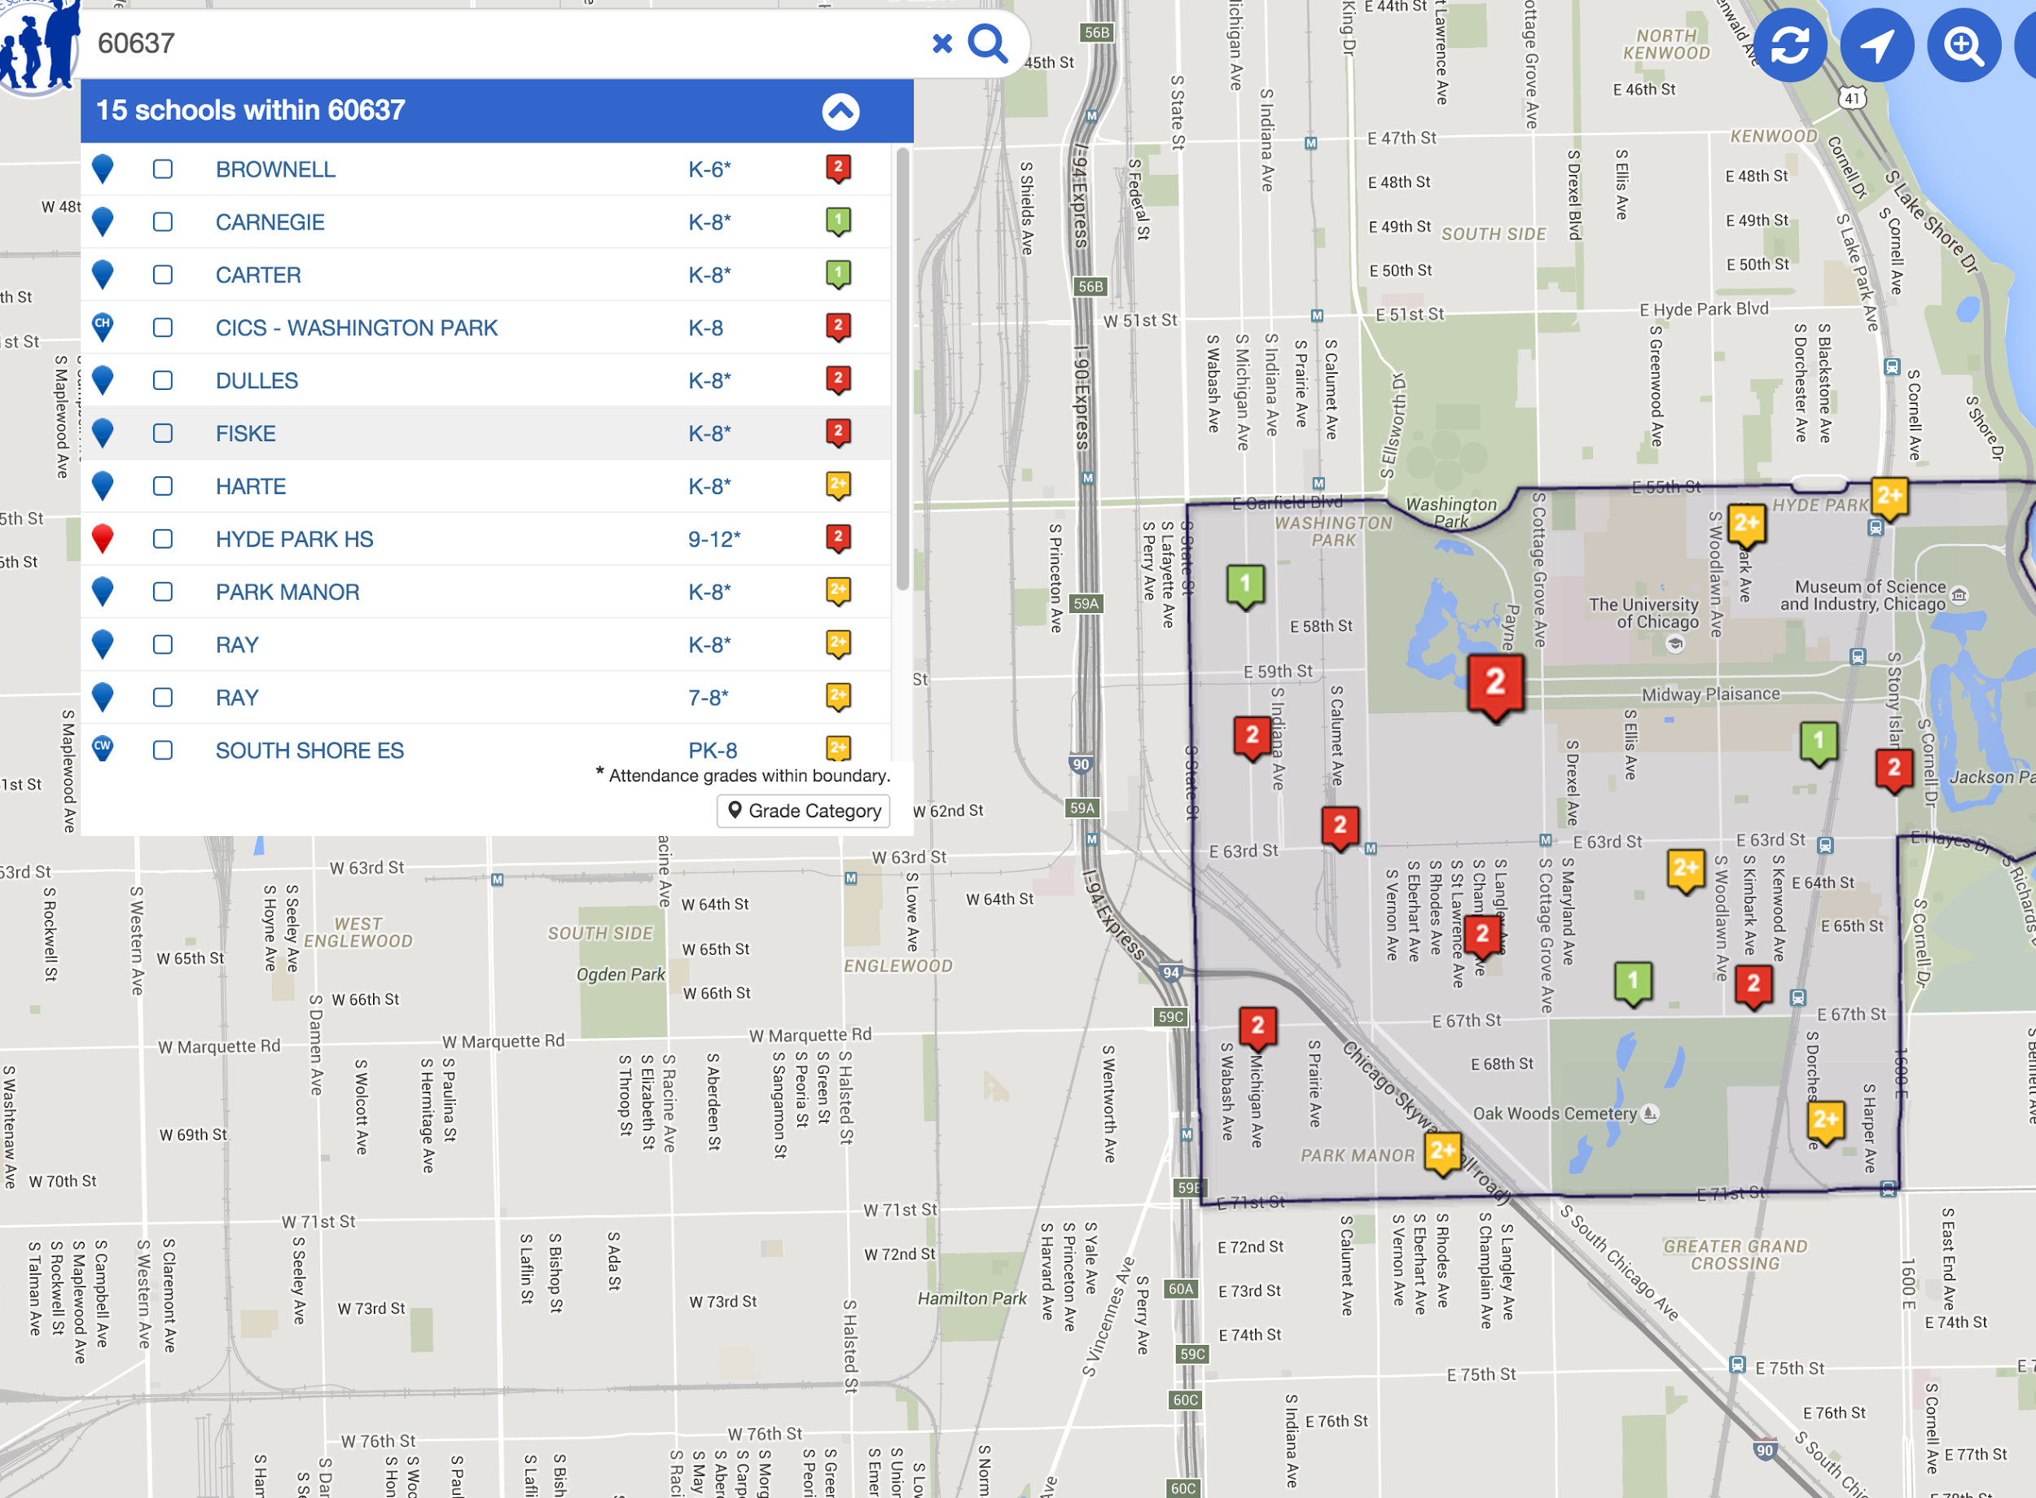
Notes:
Current tool that exists is provided by CPS
Only shows school in the neighborhood

Slide 4
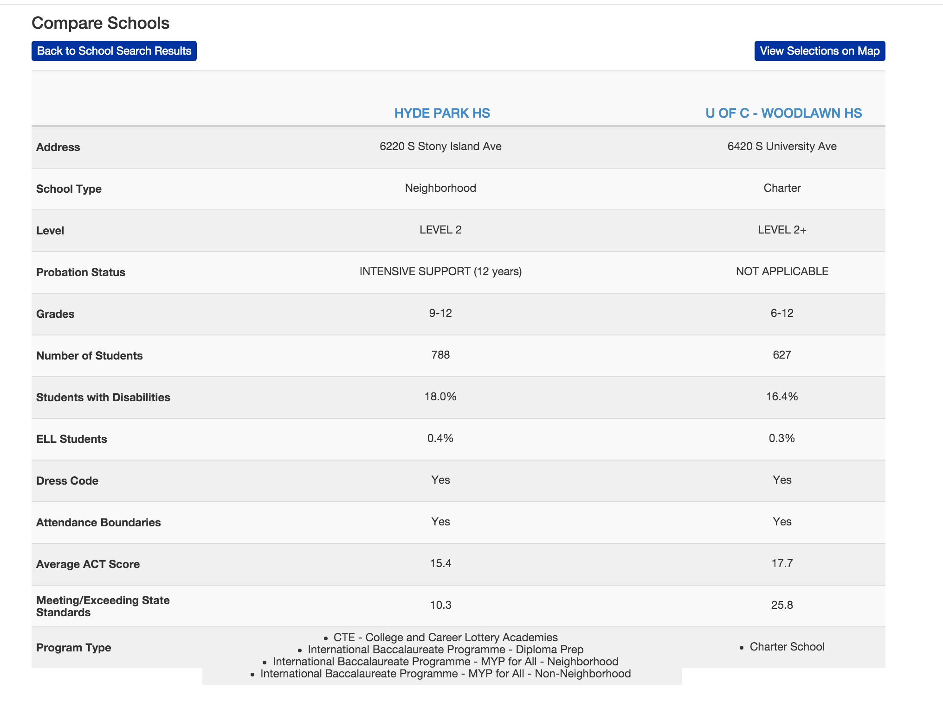
Notes:
Ability to compare is very limited
No visuals
No way to filter by type of school
No way to look at differences in distance to school

Slide 5
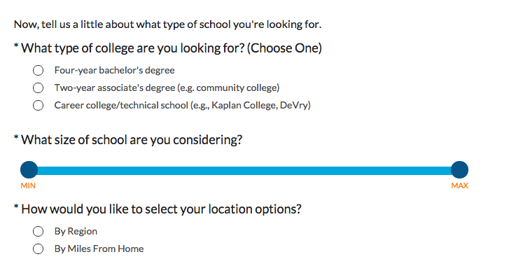
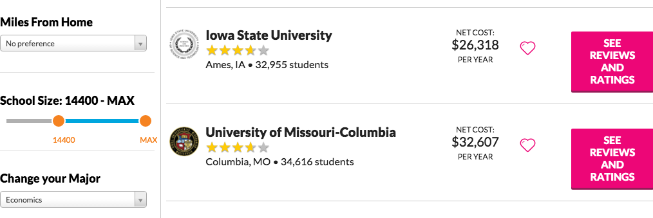
Goal
Knowledge of options
Accessibility and transparency of information
Variety of metrics
Comprehensive - everything in one place
User-friendly

Slide 6
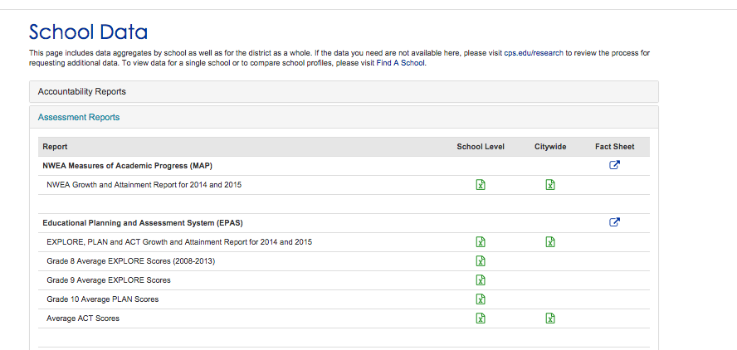
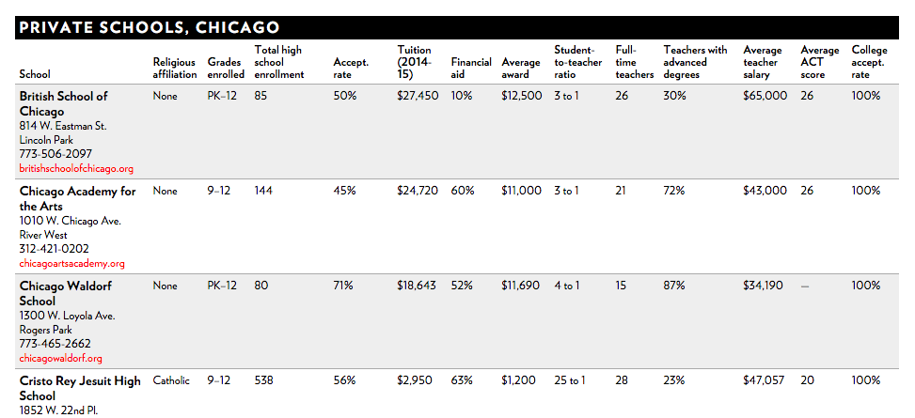
Data Sources
Chicago Public Schools website
Chicago Magazine
Google Maps API

Slide 7
Implementation
Structure:
SQL Database
Python
Web interface
Features
Ability to indicate specific preferences and data of interest
Private schools
Transportation information - address specific
Application process
Sorting and ranking algorithm

Slide 8
Timeline
5th week: extract CPS (Shelby) and private school data (Sherry)
6th week: clean data and create SQL database (Joe)
7th – 8th week: algorithm for filtering and ranking schools (Sherry and Shelby); Google Maps integration (Joe)
9th – 11th week: Django interface (Joe), final implementation (all)

